Slide 1

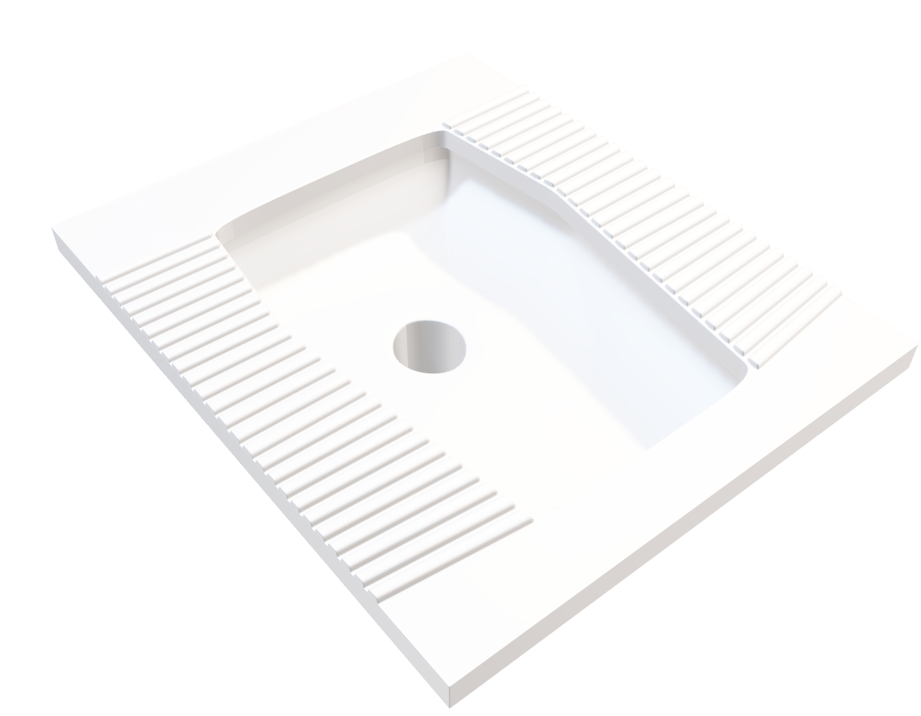
How To Design
a Perfect Squat Toilet

Slide 2

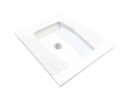
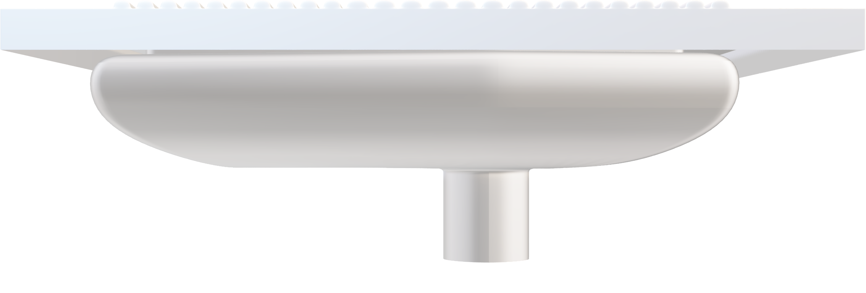
a Perfect Squat Toilet
arc
water

Slide 3
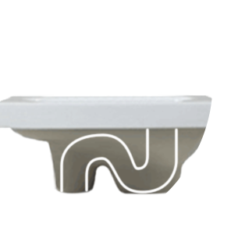
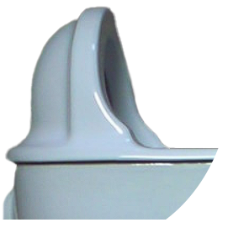


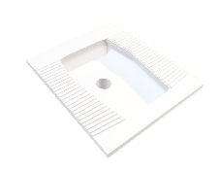
a Perfect Squat Toilet
baffle
small
arc
water
trap

Slide 4
a Perfect Squat Toilet
baffle
small
arc
water
trap

Slide 5
a Perfect Squat Toilet
small
arc

Slide 6
a Perfect Squat Toilet
small
arc
water
stick

Slide 7
a Perfect Squat Toilet
small
arc
water
water as lubricate
water
trap

Slide 8
a Perfect Squat Toilet
water
trap

Slide 9


a Perfect Squat Toilet
water
trap
stench

Slide 10
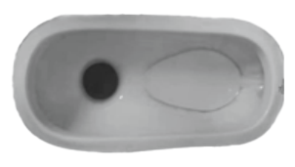

Example
water
trap
water

Slide 11
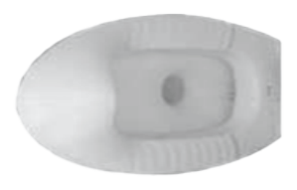
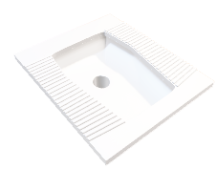
Example
No baffle
No water trap
Very Bad

Slide 12
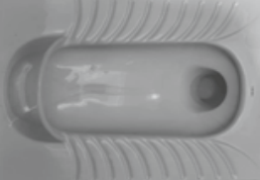
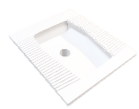
Example
Baffle
Water trap
No baffle
No water trap
No arc
Very Bad
Not Good

Slide 13


Example
Baffle
Water trap
Baffle
Water trap
Perfect
No arc
Thank you!
Not Good
Suitable arc

Slide 14

Perfect
Example
Thank you!

